Slide 1
CS 416 Web Programming HTML Basics
Dr. Williams
Central Connecticut State University

Slide 2
Homework
Homework 0 due next Tuesday 9/8
Submit a picture of your face to Blackboard, if you have a preferred name i.e. Chris rather than Christopher make a note of it in the comments.

Slide 3
Expectations
Knowing HTML isn’t a prerequisite for this class so over the next 2-3 classes you will get a crash course in it
The goal isn’t to teach you what you need to make a “cool” looking web page. The goal is to teach you just the basics needed to give you the tools you need to make a “cool” web application

Slide 4
Web pages
Web page - text document that contains:
Formatting information in a language called HTML (HyperText Markup Language)
Links to other web pages and files
Web browser takes marked up text (Web page), interprets its content, and displays the page

Slide 5
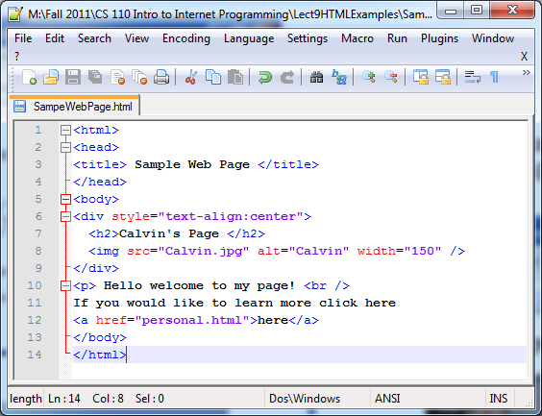
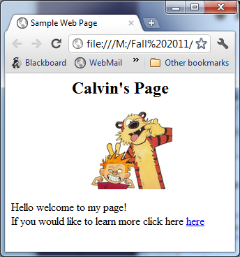

View web page (cont.)
Text document with formatting info
Browser interprets HTML and displays page

Slide 6
Web server
Internet-enabled computer that stores Web pages and provides access to the pages/files
when you request a Web page, the browser sends a request over the Internet to the appropriate server
the server locates the specified content and responds by sending it back to your computer

Slide 7
What is HTML
Language for describing web pages
It is not a programming language it is a markup language
A markup language is a set of markup tags
Markup tags are used to describe the content of the page and how it is to be displayed

Slide 8
HTML Markup Tags
HTML markup tags are generally referred to as just HTML tags
HTML tags are keywords surrounded by angle brackets <html>
HTML tags normally come in pairs like <b> and </b>
The first tag in a pair is called the start tag and the second tag the end tag or opening and closing tags

Slide 9
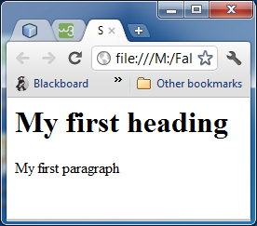
Simple example
<html>
<body>
<h1>My first heading</h1>
<p>My first paragraph</p>
</body>
</html>
Text between <html> and </html> describes the web page
Text between <body> and </body> describes the visible content of the page
Text between <h1> and </h1> is displayed as a heading
Text between <p> and </p> is displayed as a paragraph

Slide 10
Entering a Heading
Heading tag is created by using the <h1> </h1> tags
There are multiple levels of headings tags <h2></h2>,<h3></h3>,…
Heading tags create an outline of the page specifying sections of content similar to an outline you’d create for a paper
<h2>Some heading</h2>

Slide 11
Entering a Paragraph of Text
The paragraph tag <p> </p> groups together a set of text content
When there are multiple text lines paragraph tags are specified to tell the browser where to break up the text
<p> Here is some paragraph </p>

Slide 12
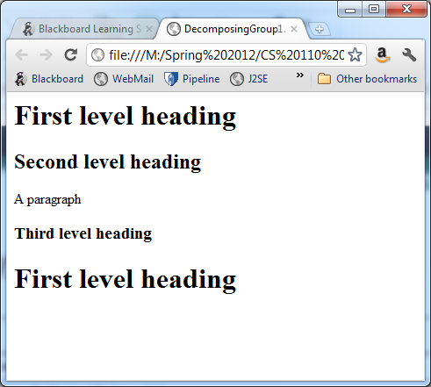
Decomposing web pages 1 as group

Slide 13
Decomposing web pages – HTML
<html>
<body>
<h1> First level heading </h1>
<h2> Second level heading </h2>
<p>A paragraph</p>
<h3> Third level heading </h3>
<h1> First level heading </h1>
</body>
</html>

Slide 14
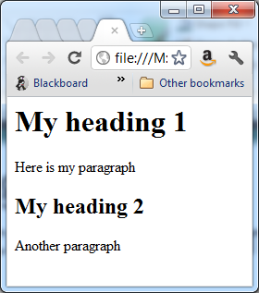
Decomposing web pages - your turn
Create the HTML for the following web page

Slide 15
Solution Ex. 1
<html>
<body>
<h1>My heading 1</h1>
<p>Here is my paragraph</p>
<h2>My heading 2</h2>
<p>Another paragraph</p>
</body>
</html>

Slide 16
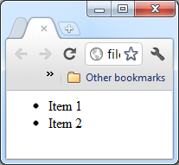
Creating an Unordered List
Unordered list are bullet point lists
You specify to create a list using
<ul> </ul>
You specify the bullet point items within the unordered list using
<li> </li>
Ex.
<ul>
<li>Item 1</li>
<li>Item 2</li>
</ul>

Slide 17
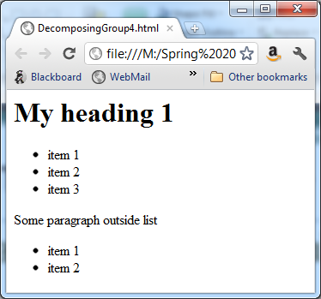
Decomposing web pages as group
Create the HTML for the following web page

Slide 18
Decomposing web pages HTML
<html>
<body>
<h1>My heading 1</h1>
<ul>
<li>item 1</li>
<li>item 2</li>
<li>item 3</li>
</ul>
<p> Some paragraph outside list</p>
<ul>
<li>item 1</li>
<li>item 2</li>
</ul>
</body>
</html>

Slide 19
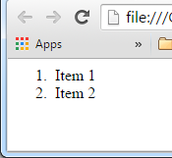
Creating an Ordered List
Ordered list are sequential/numbered lists
You specify like unordered list but using
<ol> </ol>
You specify the items within the ordered list using
<li> </li>
Ex.
<ol>
<li>Item 1</li>
<li>Item 2</li>
</ol>

Slide 20
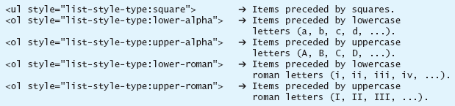
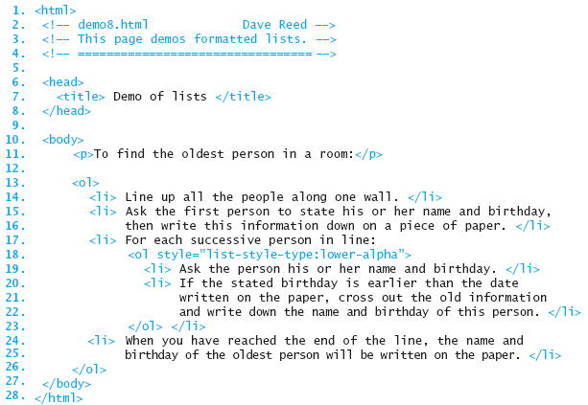
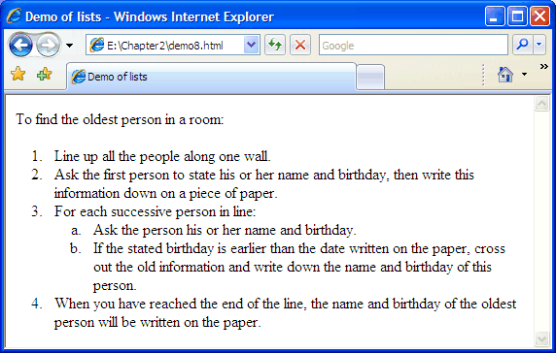
Lists (cont.)
a style attribute can be used to format the list elements

Slide 21
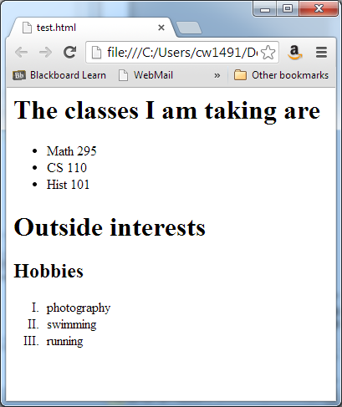
Decomposing web pages – your turn
Create the HTML for the following web page

Slide 22
Changing appearance
To emphasize sections of text, tags can be used to alter text appearance
<b>text</b> - makes text bold
<u>text</u> - makes text underline
<i>text</i> - makes text italics

Slide 23
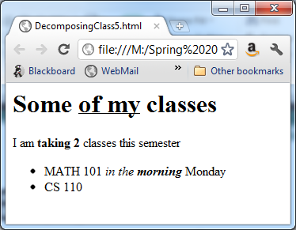
Decomposing web pages – your turn
Create the HTML
Bolded

Slide 24
Solution Ex. 5
<html>
<body>
<h1>Some <u>of my</u> classes</h1>
<p>I am <b>taking 2</b> classes this semester</p>
<ul>
<li>MATH 101 <i>in the <b>morning</b></i> Monday</li>
<li>CS 110</li>
</ul>
</body>
</html>

Slide 25
Adding an image
Image is specified by using the <img> tag
Unlike most tags the image tag does not have a separate closing tag it is closed within itself <img />
Some tags have attributes associated with them
Attributes specify characteristics of the tag

Slide 26
<img/> tag
Image tag attributes
Attribute | Purpose
src | Specifies the source of the image. This can be a local file or a file anywhere on the net
alt | Text to display if an image fails to load
width | Specifies the width of the image
height | Specifies the height of the image

Slide 27
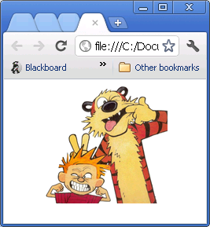
Specifying attributes
Attributes are specified inside the tag in the form:
attribute-name=“value”
<img src=“calvin.jpg” alt=“calvin” />
<html>
<body>
<img src=“calvin.jpg”
width=“200” />
</body>
</html>

Slide 28
Style
By using attributes the style of text can be changed
<h1 style=“color:blue”>My heading</h1>
<p style=“font-style:italic”>some text </p>
<h2 style=“text-align:center”>some text</h2>
<ul style=“color:green;font-style:italic”>

Slide 29

Combining elements
<html>
<body>
<h1 style="color:blue">My title</h1>
<h1 style="color:red;font-style:italic">My title</h1>
<img src="calvin.jpg" width="200"/>
</body>
</html>

Slide 30
Span tag
Style can be added to an entire tag such as a paragraph or header, but can also be used to format some portion of that content
<span> tag used with style attribute allows a portion of text to be formatted
Here is some red text
<p>Here is some
<span style=“color:red”>red</span> text </p>

Slide 31
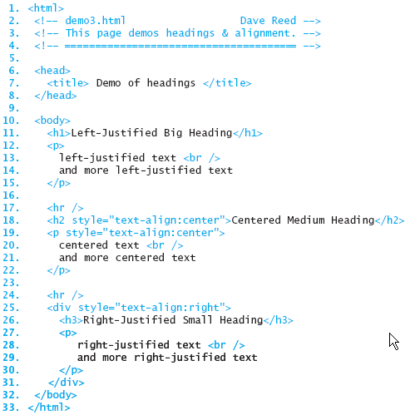
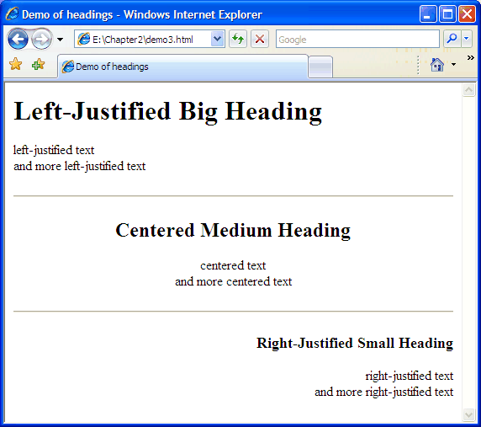
Alignment (cont.)
the DIV element groups multiple elements, so can be formatted together

Slide 32
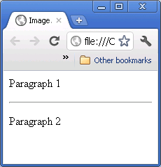
Adding a horizontal rule
A horizontal rule creates a line across the page
Tag for creating the horizontal rule is <hr> and like the image tag it is closed within the tag itself <hr/>
<html>
<body>
<p>Paragraph 1</p>
<hr/>
<p>Paragraph 2</p>
</body>
</html>

Slide 33
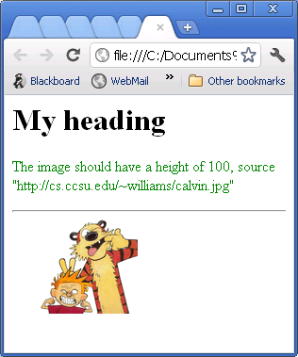
Decomposing pages as group

Slide 34
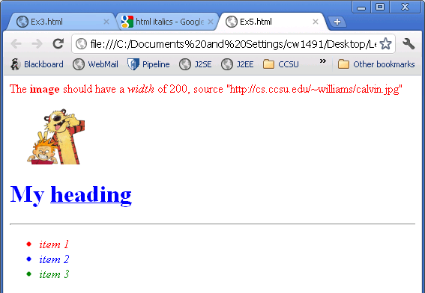
Decomposing

Slide 35
Header of pages
So far we have been working with the content of the page or the elements within the <body> of the page
The <head> of the document specifies information that is created/specified before the body
For example the title that is displayed at the top of the browser

Slide 36
The <head>
Within the HTML document the head is the first element that comes after the opening tag of <html>
Within the head you can specify the title of the page using the <title> element
It is also where you can specify Javascript for page which we will talk about later

Slide 37
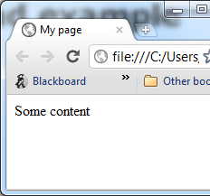
Head example
<html>
<head>
<title>My page</title>
</head>
<body>
Some content
</body>
</html>

Slide 38
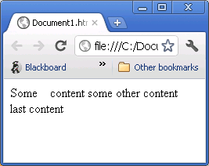
Spacing in HTML
HTML ignores multiple spaces and line returns in your HTML
In order to create a new line in HTML you have to tell the browser to specifically break a line with the <br/> (break) element
To add additional spaces use &nbsp;
<html>
<body>
Some &nbsp; &nbsp;content
some other content<br/>
last content
</body>
<html>

Slide 39
Comments
In addition to display elements you also are able to add comments
Comments are descriptions of information related to the page to make your page easier to understand but are not shown to the user
<!--demo1.html Chad Williams -->is a COMMENT element

Slide 40
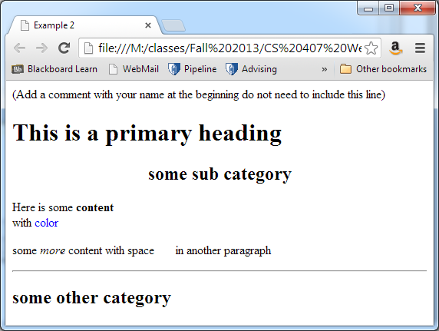
Decomposing

